Slide 1

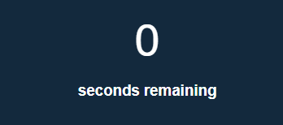

Need high score box

Slide 2
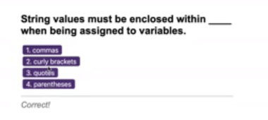
Fresh display block, question, multiple choice, “correct” text on click.

Slide 3

Final score,
Enter name
Submit

Slide 4

High scores page
Name- local storage
Clear local storage

